Slide 1



A Practical Guide for NSOs on Addressing Nonresponse Bias in Social Surveys
IASS/ISWGHS joint Webinar 64 - May 19, 2026
The 2025 HLG-MOS ASCENT Project:
Kenza Sallier (Statistics Canada)
Cilanne Boulet (Statistics Canada)
Eric Lesage (INSEE)

Slide 2
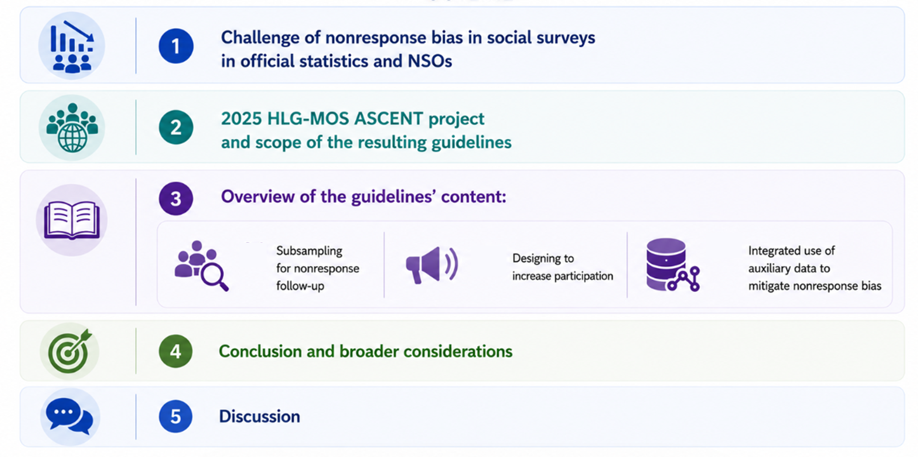
OUTLINE

Slide 3
CONTEXT & SCOPE

Slide 4
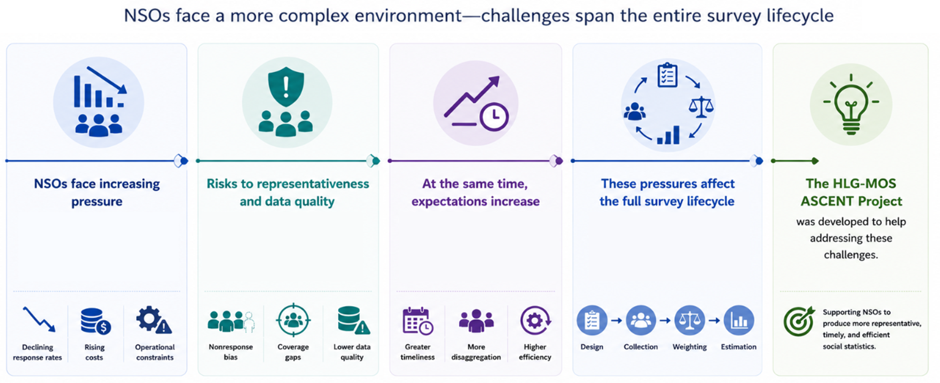
Context : Pressures on Social Survey Production

Slide 5
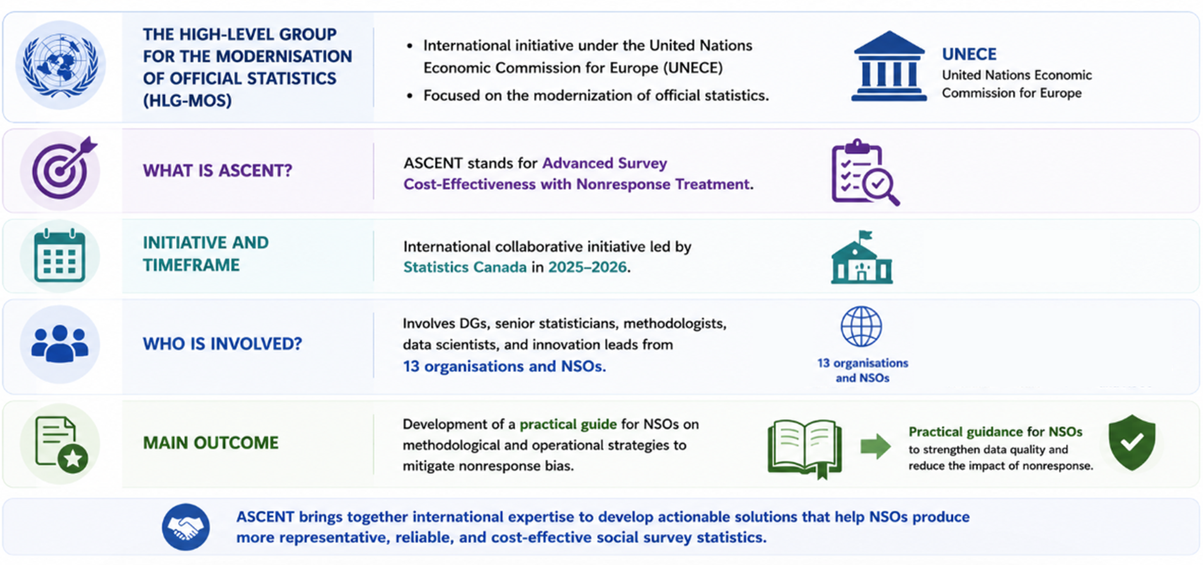
The 2025 HLG-MOS ASCENT Project - Overview

Slide 6
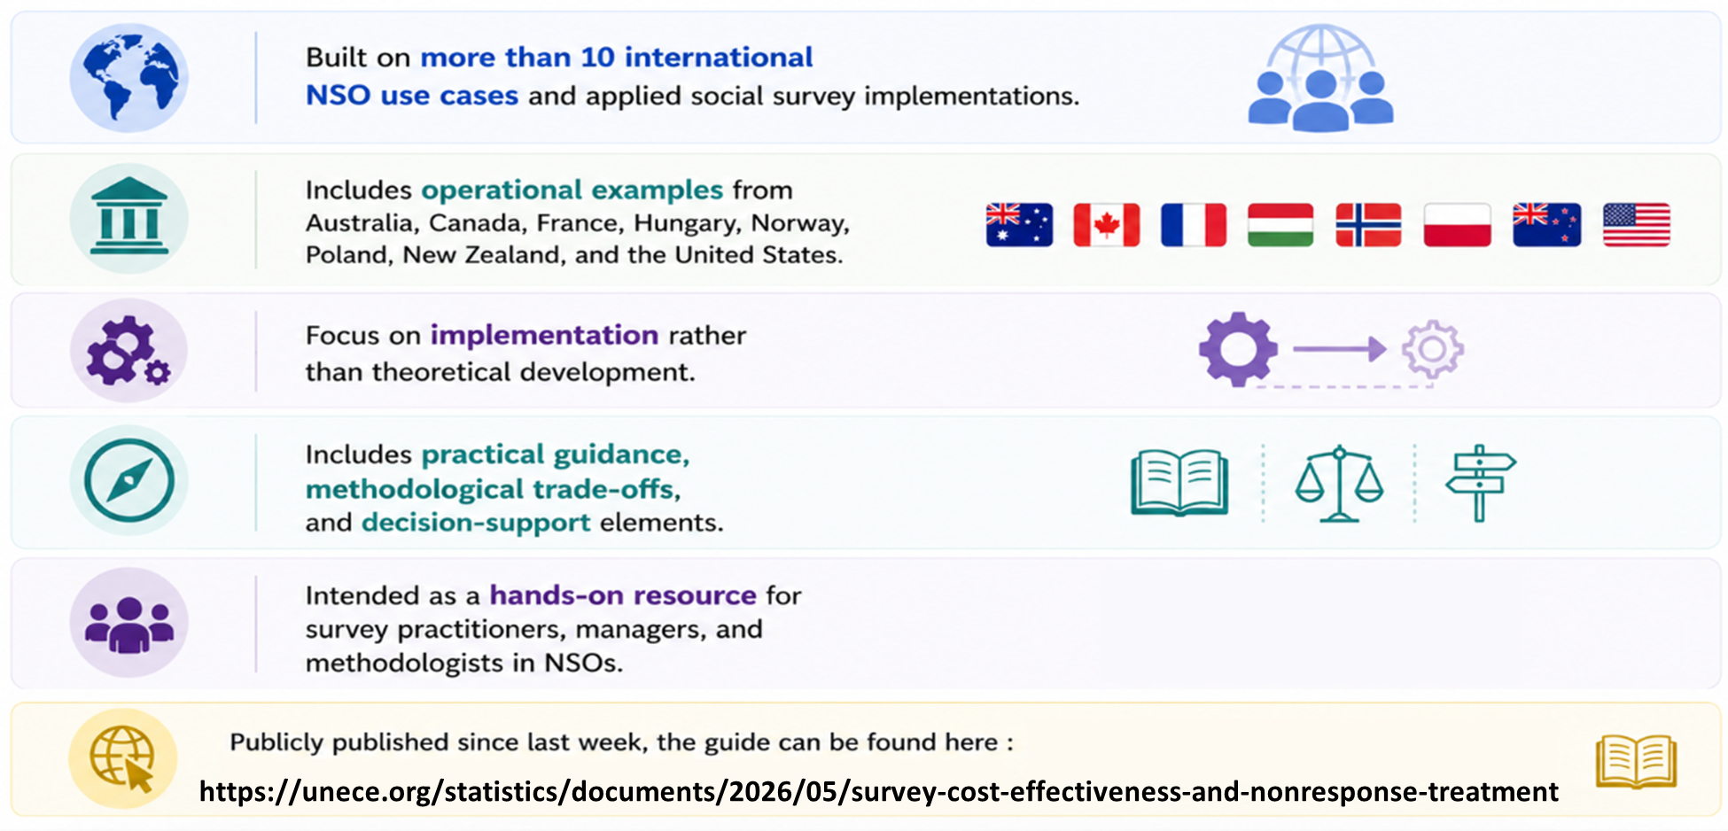
The Guide : Key Features at Glance

Slide 7
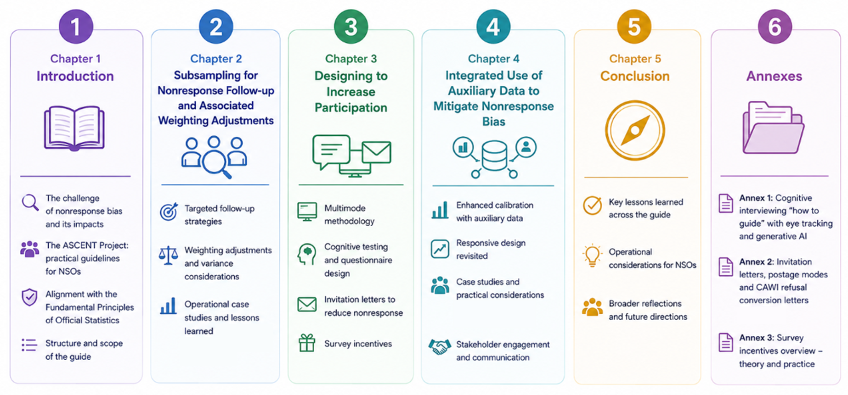
The Guide is Organized Into 6 Parts

Slide 8
Overview of Chapter 2:
Subsampling for Nonresponse Follow-up

Slide 9
Overview of Chapter 2:
Subsampling for Nonresponse Follow-up
In recent years:
  Response rates have been declining
  There has been an increase in online self-response as a collection mode
  Telephone follow-up (CATI) has been getting harder and more expensive
Time to revisit a classical idea:
  Restrict expensive collection mode (for example, by telephone or in person)
  to a random subsample (Hansen and Hurwitz, 1946)
Chapter 2 is structured around three case studies:
  Australia: Survey of Income and Housing (SIH)
  USA: American Communities Survey (ACS)
  Canada: Canadian Social Survey (CSS)

Slide 10
Overview of Chapter 2:
Subsampling for Nonresponse Follow-up
Basic idea:
  Initial phase of collection using less expensive modes
    Contact modes: letters, emails, SMS
    Response modes: self-response, often online these days
  Second phase of collection using more expensive modes
    Non-response follow-up using interviewer-facilitated modes
    such as CATI or CAPI
    On a subsample of non-respondents
  Adjust weights of subsampled units
    Inflate according the proportion selected for non-response follow-up

Slide 11
Overview of Chapter 2:
Subsampling for Nonresponse Follow-up
More cost-efficient
  Increase overall sample size
    Spend more on less expensive collection modes
  Follow-up on fewer non-respondents
    Spend less on more expensive collection modes
  Balance out
    To reduce overall collection costs
    Or to increase the precision of estimates without increasing costs
Methodological complexity at sampling and weighting

Slide 12
Overview of Chapter 2:
Australia: Survey of Income and Housing (SIH)
2023-24 Survey of Income and Housing (SIH)
  Self-response, followed by personal interviews
  Coming out of the COVID-19 pandemic, the Australian Bureau of Statistics had a smaller interviewer workforce
  Did not have the capacity to conduct the desired number of interviews
Initial phase: contact by mail, request completion of online form
  Target response rate of 45%
Second phase: follow-up on 1/6th of non-respondents
  Field staff travel for doorknock reminders and to offer personal interviews
  Target response rate of 70%

Slide 13
Overview of Chapter 2:
Australia: Survey of Income and Housing (SIH)
Case study highlights
  Variance calculation ↔ Sample size calculation
  Choice of subsampling fraction based on operational considerations rather than optimality
    1/6 subsampling rate is quite a severe implementation
    Likely cost more than if a larger workforce had been available
  Subsample selected before collection
    Two sample designs
      Clustered design for cases subsampled for follow-up
      Unclustered design for cases not subsampled for follow-up
  More modest 1/3 subsampling fraction for next iteration of SIH

Slide 14
Overview of Chapter 2:
USA: American Communities Survey (ACS)
American Communities Survey (ACS)
  Two-phase subsampling design used since its inception in 2005
Initial phase: multiple mailings over two months
  Initial push to complete online
  Subsequent paper questionnaire package
  Helpline can be used to complete the questionnaire by telephone
Second phase: follow-up of non-respondents by CAPI and CATI
  Subsampling rate generally 1/3, varies between 33.3% to 100%
    Reflects optimality but rounded for operational reasons
  Since 2023, use of admin data to inform CAPI operations
    High likelihood of being vacant → initial contact in person, fewer attempts
    Less likely to be vacant → use admin data, historic response rates, and paradata to determine best cases to remove from collection

Slide 15
Overview of Chapter 2:
Canada: Canadian Social Survey (CSS)
Canadian Social Survey (CSS)
  Quick survey: 6 weeks of collection
  Two types of contact:
    Relatively inexpensive: 3 letters, 4 emails, and limited SMS messages
      Continues throughout the entire collection period
      9% of collection budget
    More expensive: CATI
      Begins 2 weeks into collection
      91% of collection budget
  Two types of responses:
    78% self-response
    22% by phone
Large difference in cost per completed questionnaire

Slide 16
Overview of Chapter 2:
Canada: Canadian Social Survey (CSS)
Trialed subsampling three times
 | Baseline (2021-2025) | Wave 7 (Fall 2022) | Wave 12 (Winter 2024) | Wave 17 (Spring 2025)
Sample size | 20,000 | 20,000 | 34,000 | 30,000
Eligible for full follow-up | 20,000 | 15,000 (75%) | 17,000 (50%) | 12,000 (40%)
Picture
Estimated cost rel. to baseline | --- | Lower (-16%) | Same | Lower (-17%)
Precision rel. to baseline (effective sample size) | --- | Lower (-20%) | Higher (+50%) | Higher (+16%)
CATI
No CATI

Slide 17
Overview of Chapter 2:
Canada: Canadian Social Survey (CSS)
Case study highlights
  Major difference: Concurrent phases
  Weighting: Developed the Concurrent Multi-Mode Estimator (CMME)
    Uses a model to account for differences between the full follow-up subsample (with CATI) and the reduced follow-up subsample (no CATI)
    Model can incorporate variables collected on the survey, as well as frame variable
  Bias analysis conducted on CSS Wave 12
    Not fully corrected by the model, but small
    Mostly on questions susceptible to social desirability bias
      Assumption that responses from the full follow-up group are less biased is debatable
    Deemed to be acceptable, particularly when compared to gains in precision
  Examination of various more and less aggressive subsampling scenarios

Slide 18
Overview of Chapter 2:
Recommendations and Lessons Learned
Recommendations and Lessons Learned
Implementation
Separate collection phases
Determining subsampling rates
Management
Budget planning
Contingency planning
Organisational Risks
Reputational risk related to respondent expectations
Select subsample prior to collection
Survey documentation
Systems testing
Communications
Lower perceived quality
Data equity
Workforce size
Cumulative response burden

Slide 19
Overview of Chapter 3:
Designing to Increase Participation

Slide 20
Overview of Chapter 3:
Designing to Increase Participation
Multimode Data Collection
Lower access barriers
In line with modern communication methods
Invitation Letters to Reduce Nonresponse
Influence initial engagement
Cognitive Testing and Questionnaire Design
Improve question clarity
Reduce respondent burden
Survey incentives
Strengthen motivation to respond
Common Objective shared
Improving response rates and data quality upstream
Reducing reliance on more complex or costly adjustments later in the process
Post Collection Aspects
Multimode data collection comes along with methodological issues
  Nonresonse adjustment
  Mode effects assessement

Slide 21
Overview of Chapter 3:
Designing to Increase Participation
Multimode Data Collection
Lower access barriers
In line with modern communication methods
Invitation Letters to Reduce Nonresponse
Influence initial engagement
Cognitive Testing and Questionnaire Design
Improve question clarity
Reduce respondent burden
Survey incentives
Strengthen motivation to respond
Common Objective shared
Improving response rates and data quality upstream
Reducing reliance on more complex or costly adjustments later in the process
Post Collection Aspects
Multimode data collection comes along with methodological issues
  Nonresonse adjustment
  Mode effects assessement

Slide 22
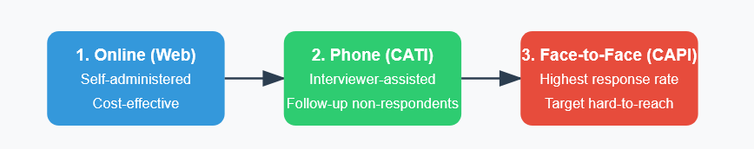
Overview of Chapter 3:
Multimode Data Collection
Transition Towards Multimode Survey Designs
Is driven by the growing feasibility and acceptance of web data collection
Offers several notable advantages
Raises multiple methodological challenges
Methodological Challenges in multimode context
Combination of data collection modes
Mode effects issues
Re-evaluation of concepts and procedures that were well mastered under single-mode designs
Case Study (France):
Insee’s 2023–2024 Housing Survey
Case Study (Poland):
Household Budget Survey

Slide 23
Overview of Chapter 3:
Addressing Measurement Effects in Multimode Surveys
Data collected may differ from the true values
For different reasons: satisficing , social desirability bias, questionnaire design
Introduction of multimode data collection does not only entail a risk of break in series when the protocol is changed...
... it can also lead to changes in comparisons between subgroups if they are not represented uniformly in the different collection modes.
Before Collection
Preventive work: pilot survey or a cognitive test with users
Planification for one or two control samples to model the measurement error mechanisms
Detection and estimation of measurement effects
Comparison of the estimates produced from:
  the multimode sample and the face-to-face control sample
  two sequential multimode protocols with reversed order of modes
Matching methods between two modes + Sensitivity analysis
Adjusting for Measurement Effects
Limited number of approaches are implemented
  (Parsimonious) imputation methods,
  Reweighting through calibration
  Restricting comparisons to a single collection mode

Slide 24
Overview of Chapter 3:
Weighting in Multimode Surveys
Nonresponse in Multimode Surveys
Multimode survey collection is an essential tool to keep response rates at acceptable levels
Sequential multimode mode surveys are generally assumed to follow a MAR mechanism
Modeling overall nonresponse in a multimode survey can follow the standard approaches used to correct for nonresponse, without taking collection modes into account.
Using an Additional Single-Mode Internet Sample
✅ Control sample used to study mode effects
 Whether it provides gains in precision is not a straightforward issue
An excessive size would bring only marginal gains in accuracy and would increase the response burden.

Slide 25
Overview of Chapter 3:
Case Studies
France (Insee)
2023–2024 Housing Survey
Multimode protocole with 3 samples
Sequential multimode sample of 27,300 dwellings (first internet, then telephone, and finally face-to-face)
Face-to-face control sample of 3,500 households
Internet-only control and experimental sample of 50,000 dwellings.
Nonresponse adjustment
The face-to-face sample and the multimode sample had a similar response rate of 70%
Internet-only sample had a reponse rate lower than 30%
Data collected through the face-to-face protocol were included in the final data set
Measurement effect
Household reporting living in housing they considered too dark
  9.6% in the multimode sample
  10.9% in the face-to-face sample.
  This discrepancy illustrates the potential impact of mode effects on survey responses
Model to disentangle measurement effects from selection bias
  9.2% (95%-confidence interval: [8.7%; 9.7%]) confirms the presence of measure effects.

Slide 26
Overview of Chapter 3:
Case Studies
Poland (Statistics Poland)
Household Budget Survey (HBS)
Multi-mode collection strategy
In 2016, CAPI for the questionnaire and a paper version (PAPI) or an online electronic version (CAII) for expenditure diary
In 2018, a receipt-based method was introduced as an additional data collection mode
CATI during the COVID-19
Effects on response and data quality
Interviews conducted with tablets perceived as more professional
Reduction of the reporting burden
In the post-pandemic period, response rates partially recovered. However, refusals increased again, indicating that broader social and behavioral factors increasingly influence survey participation
beyond data collection modes alone.

Slide 27
Overview of Chapter 3:
Cognitive testing and questionnaire design
The Hungarian Central Statistical Office has developed a detailed and practice-oriented document on cognitive interviewing for questionnaire testing
Identify and reduce specification, measurement, and nonresponse errors prior to quantitative testing
Qualitative studies, such as cognitive interviews, are low-cost instruments compared with large-scale quantitative tests or pilot surveys
When sufficient budget and time are available, the most robust approach is to combine the explanatory strength of qualitative methods with the statistical power of quantitative testing
Steps of a Cognitive Test Study
Expert reviews
Pre-evaluation of questions
Sample design and recruitment
Preparing and conducting the cognitive interview
Analysis
The integration of eye tracking
Testing CAWI self-completion questionnaire of the 2022 Hungarian Census
Generative AI in Cognitive Interviewing
A “human-first” model, in which cognitive testing is conducted entirely by human researchers before any optional use of generative AI as a supplementary tool

Slide 28
Overview of Chapter 3:
Invitation Letters to Reduce Nonresponse
Invitations to take part in a population survey—especially when participation is voluntary—are a critical determinant of both response rates and data quality
A traditional approach, characterized by a formal tone, standardized wording, and an official layout, often aligned with surveys where participation is mandatory
A more recent, respondent-centred approach, using clearer language, a more engaging tone and design, and drawing on behavioural insights to encourage participation.
Two approaches
The Hungarian Central Statistical Office reports a series of quantitative experiments conducted to improve web survey response rates through invitation letters, postage modes, and refusal conversion letters
Overall, the findings suggest that authoritative and authentic official communication—especially when combined with priority postage—remains the most effective strategy
Preliminary results suggest that electronic invitations can be used as auxiliary means to increase web self-completion rates, but they may be much less effective as standalone means of communication than postal letters.

Slide 29
Overview of Chapter 3:
Survey incentives
Incentive Types
Incentives may be categorized by their form, conditionality, value, and mode of distribution
Theoretical Foundation
The main theoretical foundations are well established in the literature and provide complementary explanations of response behaviour through different but interconnected mechanisms.
Incentive effects and Design Implications
Generally, unconditional incentives and cash were found to be more effective than conditional incentives and gifts
In longitudinal surveys, the added value of proper incentivization is that early wave incentives may positively impact retention across waves
As a final conclusion
The use of incentives does not mechanically lead to better response propensity and lower nonresponse
In the context of official statistics, avoiding incentives altogether may be preferable, particularly for sensitive topics

Slide 30
Overview of Chapter 4:
Integrated Use of Auxiliary Data to Mitigate Nonresponse bias

Slide 31
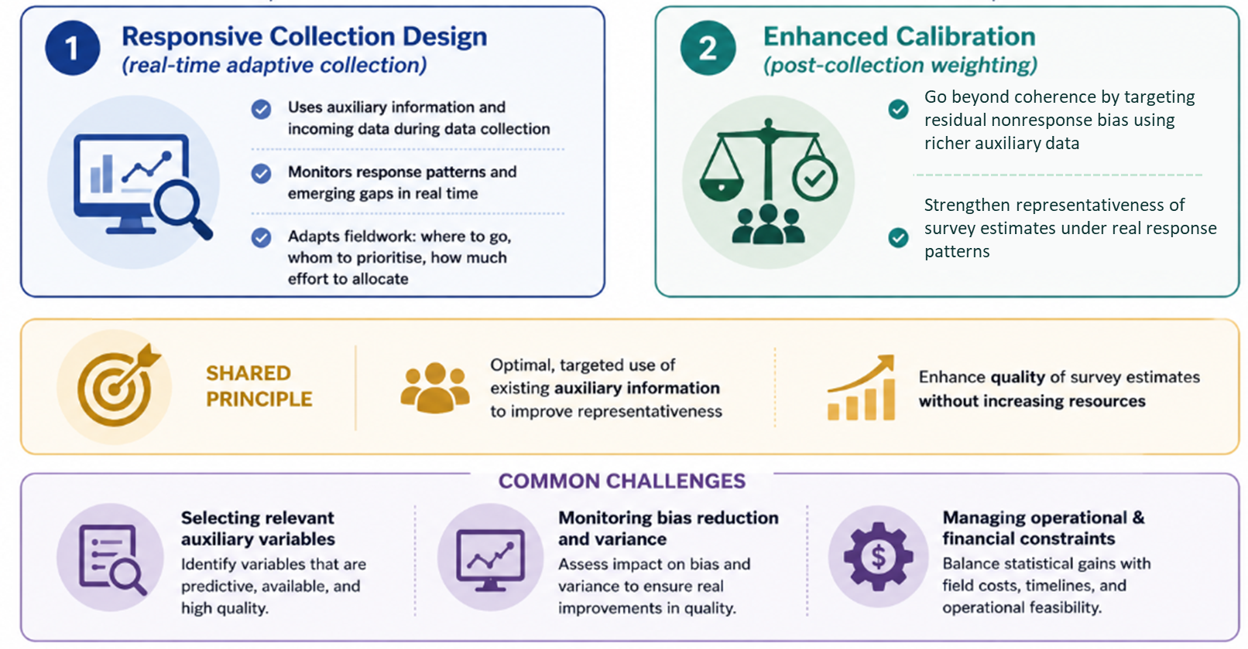
Overview of Chapter 4:
Integrated Use of Auxiliary Data to Mitigate Nonresponse bias

Slide 32




Overview of Chapter 4:
Responsive Design
1
CORE IDEA
Improve sample representativeness
By leveraging existing information on respondents’ likelihood to participate.
Likelihood to Respond
Target follow-up using predicted response propensities based on characteristics instead of paradata
Low
High
1
2
METHODOLOGICAL APPROACH
Estimate response propensity for each sample unit using auxiliary information
Group units into propensity deciles
Adapts collection in teal time by reallocating effort
Variable selection process
Continuously updates diagnostics
Propensity Deciles
Lower propensity
(less likely to respond)
Higher propensity
(more likely to respond)
Weight
variability
Operational
efficiency
Representativeness

Slide 33


Overview of Chapter 4:
Responsive Design
3
KEY TAKEAWAY
Improve sample representativeness
By leveraging existing information on respondents’ likelihood to
Advice and methodological considerations for variable selection
4
AUSTRALIAN BUREAU OF STATISTICS
STATS NORWAY
TIME USE SURVEY
Predicted deciles to target low-response households.
Higher diary completion and lower estimate variance
GENERAL SOCIAL SURVEY
Deciles monitored mid-enumeration;
Low-response subpopulations (e.g., financially stressed households) were prioritized in follow-up, improving representativeness.
ADULT EDUCATION SURVEY
Responsive-design –adjacent
Exploring machine learning algorithms to predict the likelihood of break-off for web answering

Slide 34

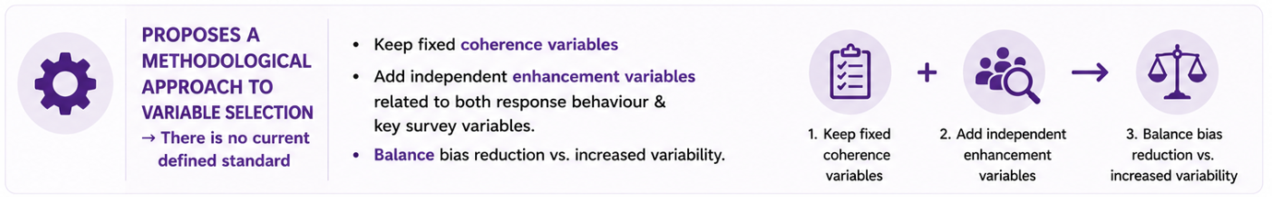
Overview of Chapter 4:
Enhanced Calibration
1
2

Slide 35
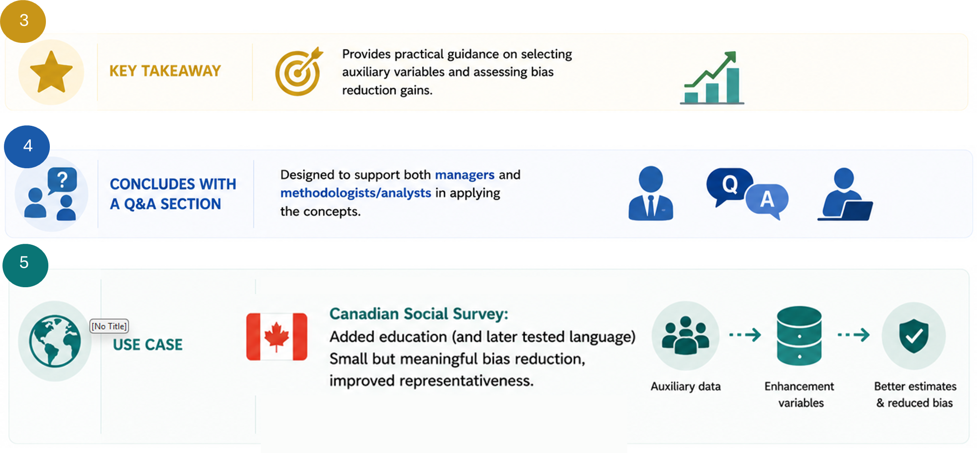
Overview of Chapter 4:
Enhanced Calibration

Slide 36
CONCLUSION

Slide 37
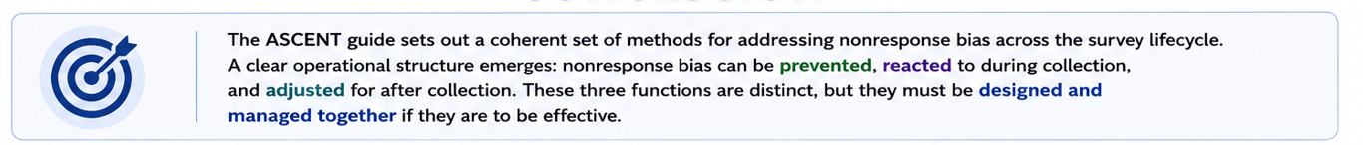
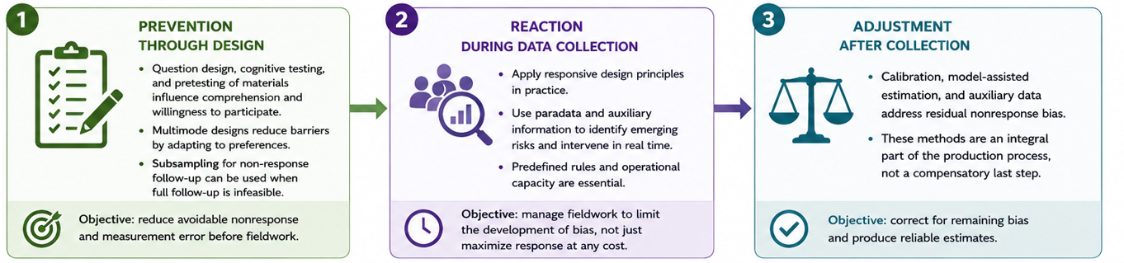
CONCLUSION

Slide 38
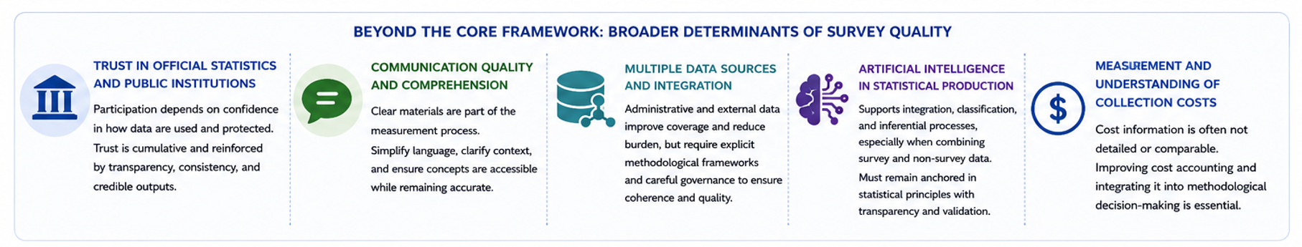

CONCLUSION

Slide 39
Thank you! Merci !
Presenters Contact Information:
kenza.sallier@statcan.gc.ca (project manager)
cilanne.boulet@statcan.gc.ca
eric.lesage@insee.fr
HLG-MOS UNECE Contact Information :
Inkyung Choi - choii@un.org

